Slide 1

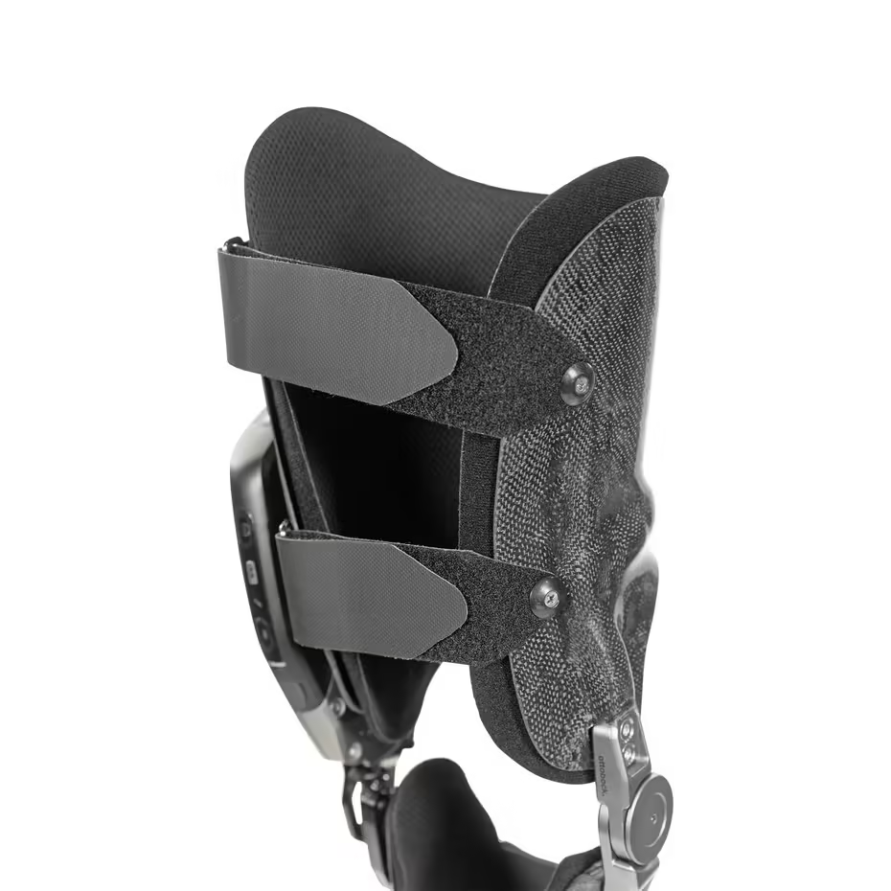
SMART ORTHOPEDIC
KNEE BRACE
INTRODUCTION TO NN, CNN and GNN(24AIM113)
ANALOG SYSTEM DESIGN(24AIM114)
Harithra S. – CB.AI.U4AIM24013
Harshath A. – CB.AI.U4AIM24015
N S Tharika. – CB.AI.U4AIM24027
RA Thanushika Sri. – CB.AI.U4AIM24034
GROUP 12

Slide 2
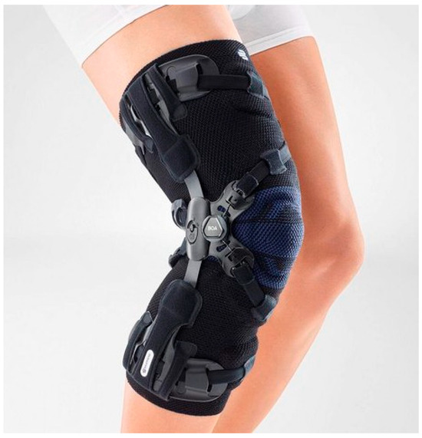
INTRODUCTION
Orthopedic rehabilitation is essential for recovery from musculoskeletal injuries, but unsupervised exercises often lead to improper movements, reinjury, or delayed progress.
Traditional physiotherapy relies heavily on clinic visits and generalized instructions, which can be costly and inaccessible for many.
This project introduces a smart orthopedic brace to address these challenges by integrating motion tracking sensors and real-time analysis using MLP.
The device aims to empower patients with accurate, personalized feedback, ensuring safe and effective rehabilitation at home.

Slide 3
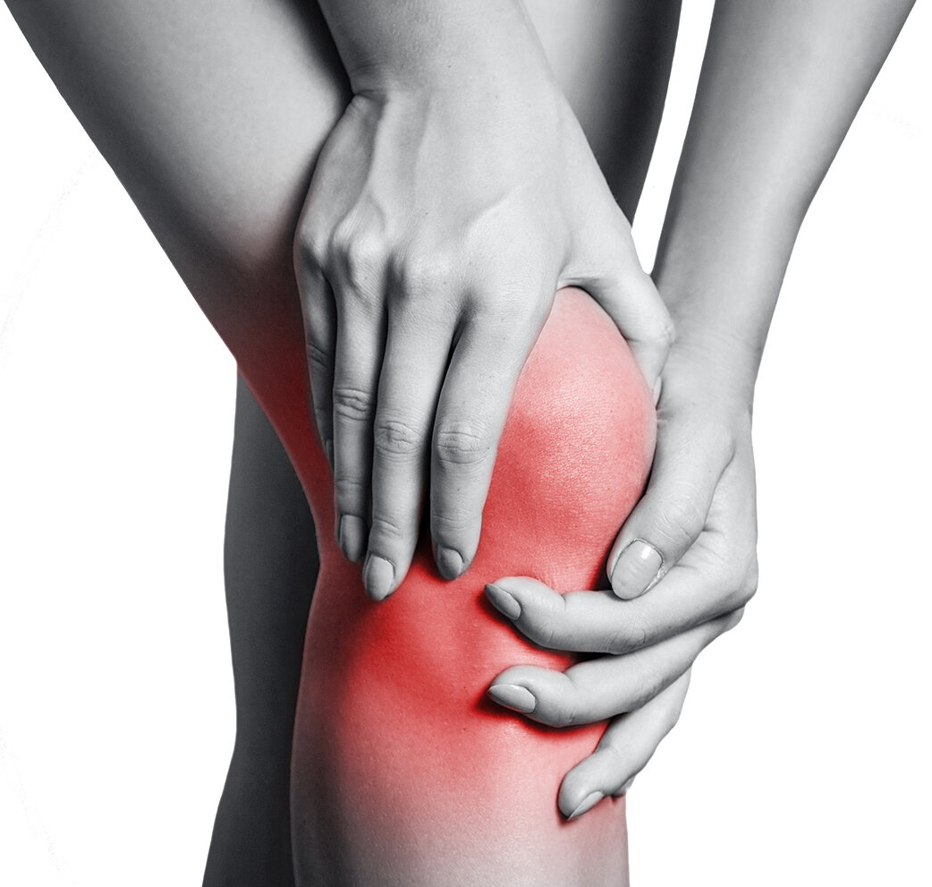
PROBLEM STATEMENT:
Orthopedic rehabilitation requires precise movements for effective recovery, but unsupervised exercises often lead to improper techniques and reinjury. Existing monitoring solutions are often inaccurate, cumbersome, or expensive, and the lack of data-driven insights hinders recovery optimization.

Slide 4
OBJECTIVES:
To Develop Real-Time Feedback Systems
To Enhance Safety and Promote Independent Recovery
To Ensure Accessibility and Affordability
To Integrate Lightweight AI for Efficient and Comfortable Use
To Track and Improve Recovery

Slide 5
LITERATURE REVIEW
SERIAL NO. | TITLE | YEAR | METHODOLOGY | KEY FINDINGS
1 | Smart Brace for Static and Dynamic Knee Laxity Measurement | 2019 | Strain sensors and IMUs for knee laxity measurement. | Provides a reliable method for ACL injury diagnosis.
2 | Toward Personalized Orthopedic Care: Validation of a Smart Knee Brace | 2020 | IMUs for real-time gait analysis, comparison with GAITRite (gold standard), pilot study using motion tracking systems. | Demonstrates moderate validity in gait analysis, with refinements suggested for clinical use.
3 | A Magnetorheological Fluid Based Orthopedic Active Knee Brace | 2021 | MR fluid technology, sensors, and actuators for adaptive support. | Offers dynamic, real-time support for rehabilitation and chronic condition management.

Slide 6
LITERATURE REVIEW
SERIAL NO. | TITLE | YEAR | METHODOLOGY | KEY FINDINGS
4 | Evaluation of a Smart Knee Brace for Range of Motion and Velocity Monitoring during Rehabilitation Exercises and an ExergamE | 2022 | Integrated sensors for ROM and velocity monitoring, gamification through an exergame. | Enhances rehabilitation with real-time feedback and gamified therapy.
5 | Design and Development of Intelligent Knee Brace for Monitoring Daily Activities | 2018 | Low-cost sensors to monitor sitting and standing positions; reminders for prolonged sitting. | Encourages movement by monitoring knee positions and reminding users to stand after extended sitting.
6 | A Novel Home-Based Rehabilitative Knee Brace System | 2022 | Motion trackers with accelerometers, angle sensors, and gyroscopes; mobile app for exercise guidance. | Offers a smart knee brace for personalized, home-based rehabilitation after ACL surgery.

Slide 7
RESEARCH GAPS
Lack of Hybrid Motion Tracking for Rehabilitation
Limited Sensor Accuracy
Lack of Large-Scale Clinical Validation
Lack of Multi-Sensor Data Fusion in Existing AI-Based Systems
Limited Focus on Patient Comfort & Wearability

Slide 8
WORKFLOW
DATA COLLECTION
DATA PREPROCESSING
MODEL TRAINING
REAL-TIME IMPLEMENTATION
Gather data from flex sensors and IMU sensors while performing movements.
Handle missing values in IMU data.
Normalize sensor readings for consistency.
Merge datasets based on timestamps.
Train an MLP neural network to classify different movements.
Use features like quaternion angles, acceleration, resistance values.
Evaluate model using learning curve, accuracy, and confusion matrix.
Provide instant movement feedback to users for correct rehabilitation execution.

Slide 9
HARDWARE IMPLEMENTATION
COMPONENTS | SPECIFICATIONS | Working Principle
FLEX SENSOR | Type: Bend-sensitive resistive sensor Resistance: Varies with bending (e.g., 10kΩ – 100kΩ) Voltage Range: 0–5V (dependent on pull-up resistor setup) Bend Angle Sensitivity: Typically ±90° | The resistance increases as the sensor bends. The voltage output changes with bending, which is read by an analog input pin on the microcontroller (e.g., Arduino). Used to measure joint angles, such as knee flexion and extension.
MU Sensor (Inertial Measurement Unit) – Accelerometer & Gyroscope | Type: MEMS-based (e.g., MPU6050, Accelerometer Range: ±2g, ±4g, ±8g, ±16g Gyroscope Range: ±250°/s to ±2000°/s Communication: I2C Sampling Rate: Typically 50 Hz or higher | Accelerometer: Measures changes in velocity to determine orientation and movement. Gyroscope: Measures angular velocity to track rotational motion. The data from the quaternion values (q1, q2, q3, q4) is used to calculate joint angles and movement patterns. Helps in detecting motion patterns like walking, squatting, and knee extensions.

Slide 10
HARDWARE IMPLEMENTATION
components | Specifications | Working principle
Microcontroller | Processor: 8-bit (Arduino) or 32-bit (ESP32/Raspberry Pi) Operating Voltage: 3.3V or 5V Analog/Digital Inputs: Required for reading flex sensor values and IMU data Communication Protocols: I2C(for IMU sensor integration) | Reads analog signals from the flex sensor and digital signals from the IMU sensor. Processes data and sends it for further classification using machine learning models. Can provide real-time feedback through an LCD screen, buzzer
Piezoelectric Buzzer | Operating Voltage 3V – 12V Current Consumption ~10-50mA Frequency Range 1kHz – 5kHz Polarity Positive (VCC) & Negative (GND) Sound Level (SPL) 85-95 dB Operating Temperature -20°C to 60°C | Real-Time Movement Feedback: The buzzer alerts users if they perform incorrect movements. Posture Correction: If the joint exceeds safe angles, a buzzer can warn the patient.

Slide 11
HARDWARE SETUP
Wiring the Flex Sensor:
Connect one end of the flex sensor to the 5V pin of the Arduino.
Connect the other end of the flex sensor to:
A0 pin of the Arduino.
One side of a 10kΩ resistor.
Connect the other side of the 10kΩ resistor to the GND rail of the breadboard.
Wiring the MPU6050 IMU Sensor:
Connect VCC of MPU6050 to the 5V rail of the breadboard.
Connect GND of MPU6050 to the GND rail of the breadboard.
Connect SCL of MPU6050 to A5 of the Arduino.
Connect SDA of MPU6050 to A4 of the Arduino.

Slide 12
Basic Steps in IMU Data Preprocessing
Basic Steps in Flex Sensor Data Preprocessing
1
Load the Dataset
1
Extract & Load Data
2
Handle Missing Values
2
Handle Missing Values
3
Encode Categorical Data
3
Filter Noise
4
Normalize Numerical Features
4
Compute Acceleration Magnitude
5
Split Data for Training & Testing
5
Convert Quaternions to Euler Angles
6
Save Processed Data

Slide 13
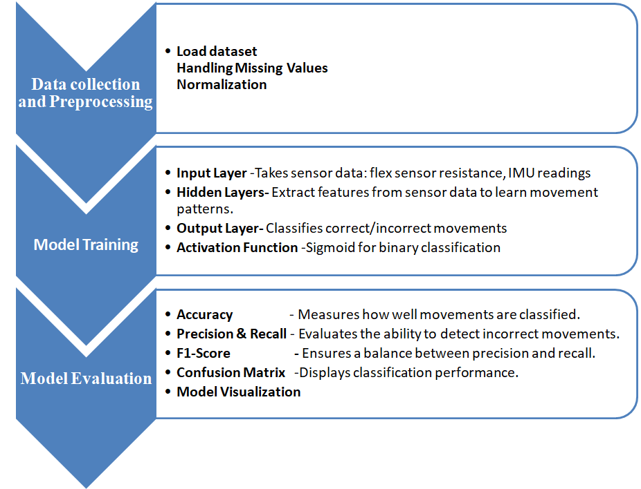
MLP Model

Slide 14
Why MLP??
•Works Well with Sensor Data
MLP handles numerical data like resistance, angles, and acceleration better than models made for sequences.
•Fast & Lightweight (Good for Arduino)
Needs less computing power, making it ideal for movement tracking on a microcontroller.
• Best for Binary Classification
Uses Sigmoid activation to classify movements as Correct (1) or Incorrect (0).
•Simple & Scalable
Easy to train, update, and improve with more movement data.

Slide 15
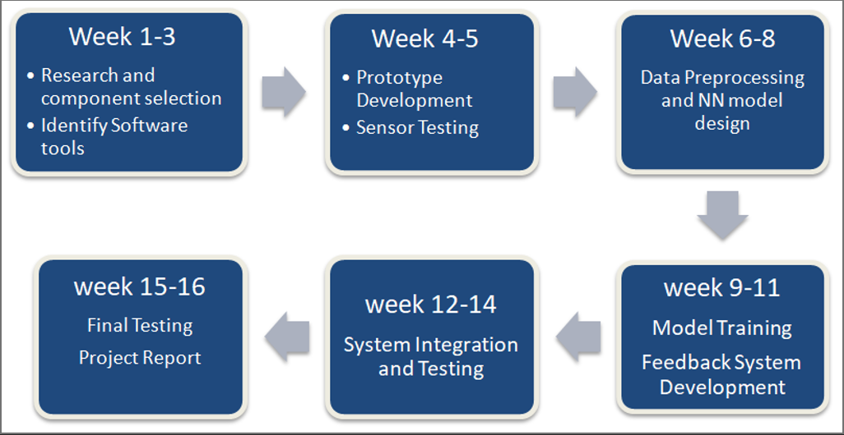
TIMELINE

Slide 16
REFERENCES:
[1]https://www.researchgate.net/figure/Smart-left-knee-brace-for-dynamic-knee-laxity-measurements-1-Femoral-unit-IMU_fig1_362495682
[2]https://www.semanticscholar.org/paper/Toward-Personalized-Orthopedic-Care%3A-Validation-of-McPherson-McDaid/0363b340b56bebddd7700e2d4efb6fca5e154c76
[3]https://www.researchgate.net/publication/241274431_A_magnetorheological_fluid-based_controllable_active_knee_brace_-_art_no_65270O
[4]https://pubmed.ncbi.nlm.nih.gov/36560329/
[5]https://dr.ntu.edu.sg/handle/10356/74662
[6]https://pubmed.ncbi.nlm.nih.gov/36149519/
Thank you!

